Slide 1

Alexa Modular Adapter
Anon Cheewakarn
Christopher Gunter
Kenneth Mai
Alexa For Everyone Team
Sarah Caplener
David Frerichs
Ken Karakotsios
Kara Kytle
Notes:
Change Screen to Default Slide.

Slide 2
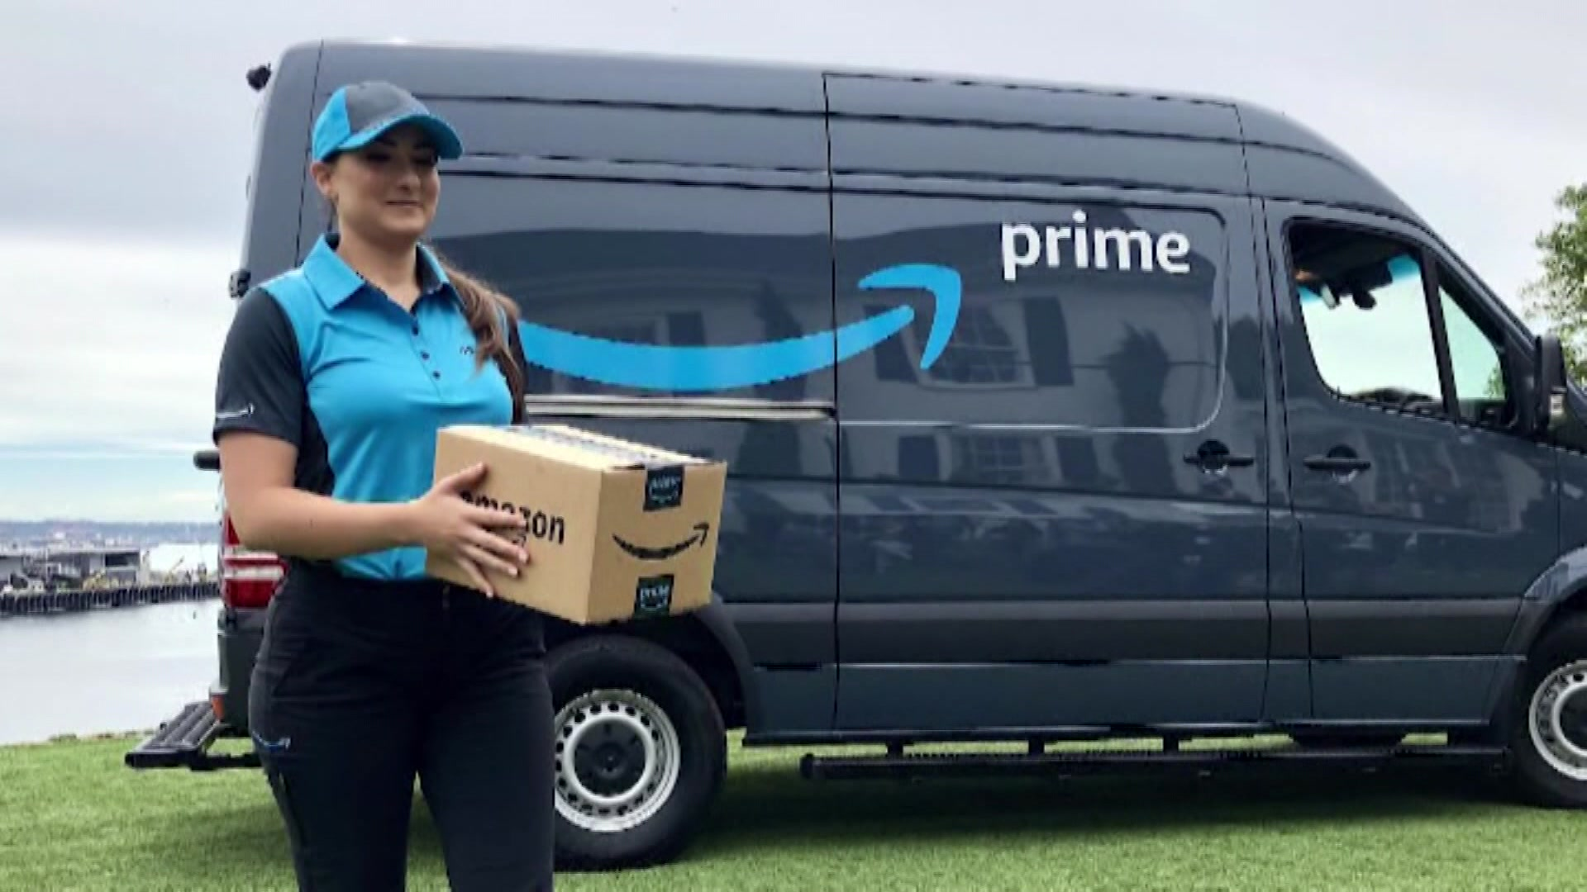
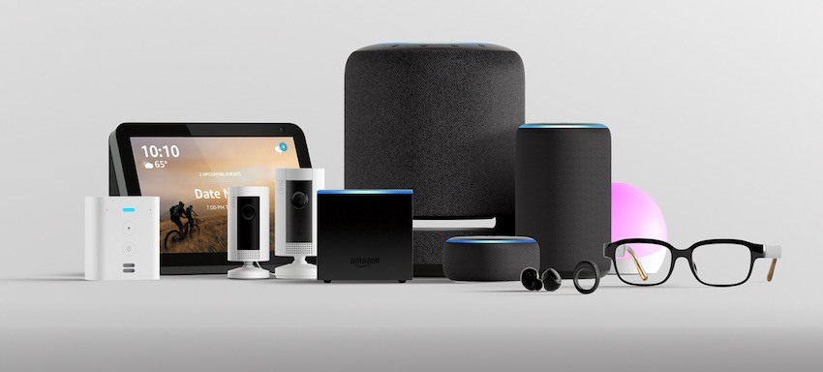

Slide 3
Growth of Alexa Platform
Notes:
Put Numbers on Pie Chart.

Slide 4
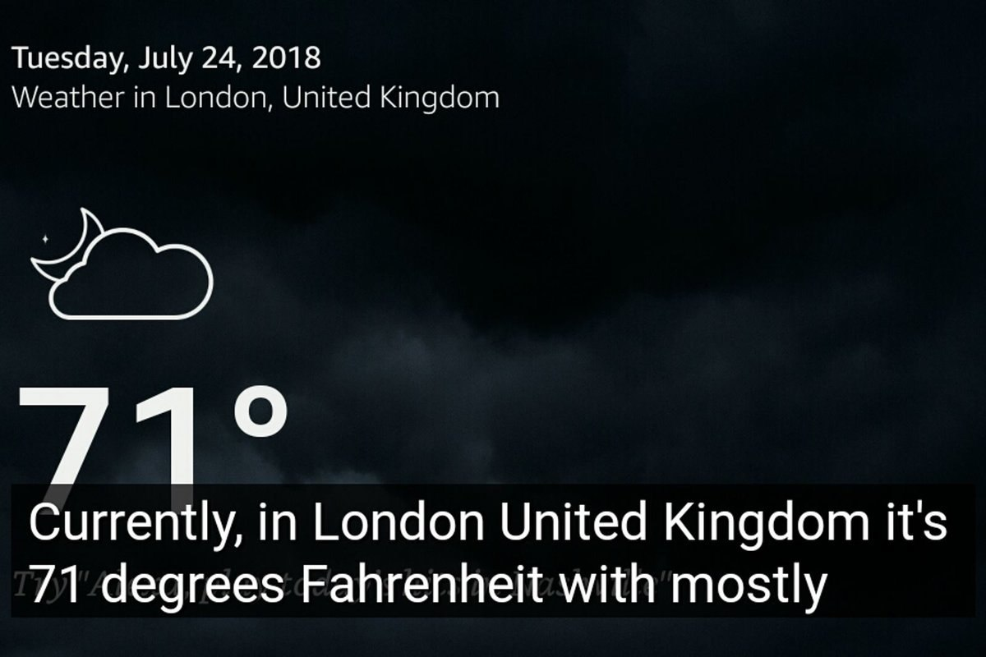
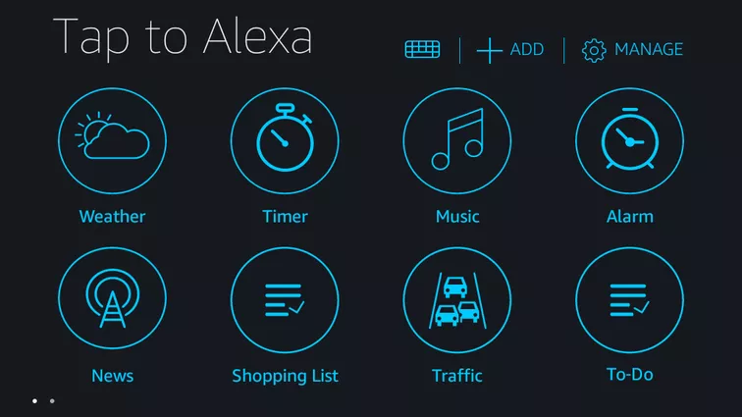
Alexa For Everyone
Worked closely with the Alexa Development Team
Worked on features like Tap to Alexa and Alexa Captioning

Slide 5
Modular Adapter
A gadget that creates a plug-and-play interface between Alexa and switch-control devices
Those switch-controlled devices chosen to be automated should have some positive impact on the disabled community

Slide 6
Putting Us In Their Shoes
From our team’s lack of experience of having to live with a disability, we had to research to see what products (if automated) could have a positive benefit for people with disabilities

Slide 7
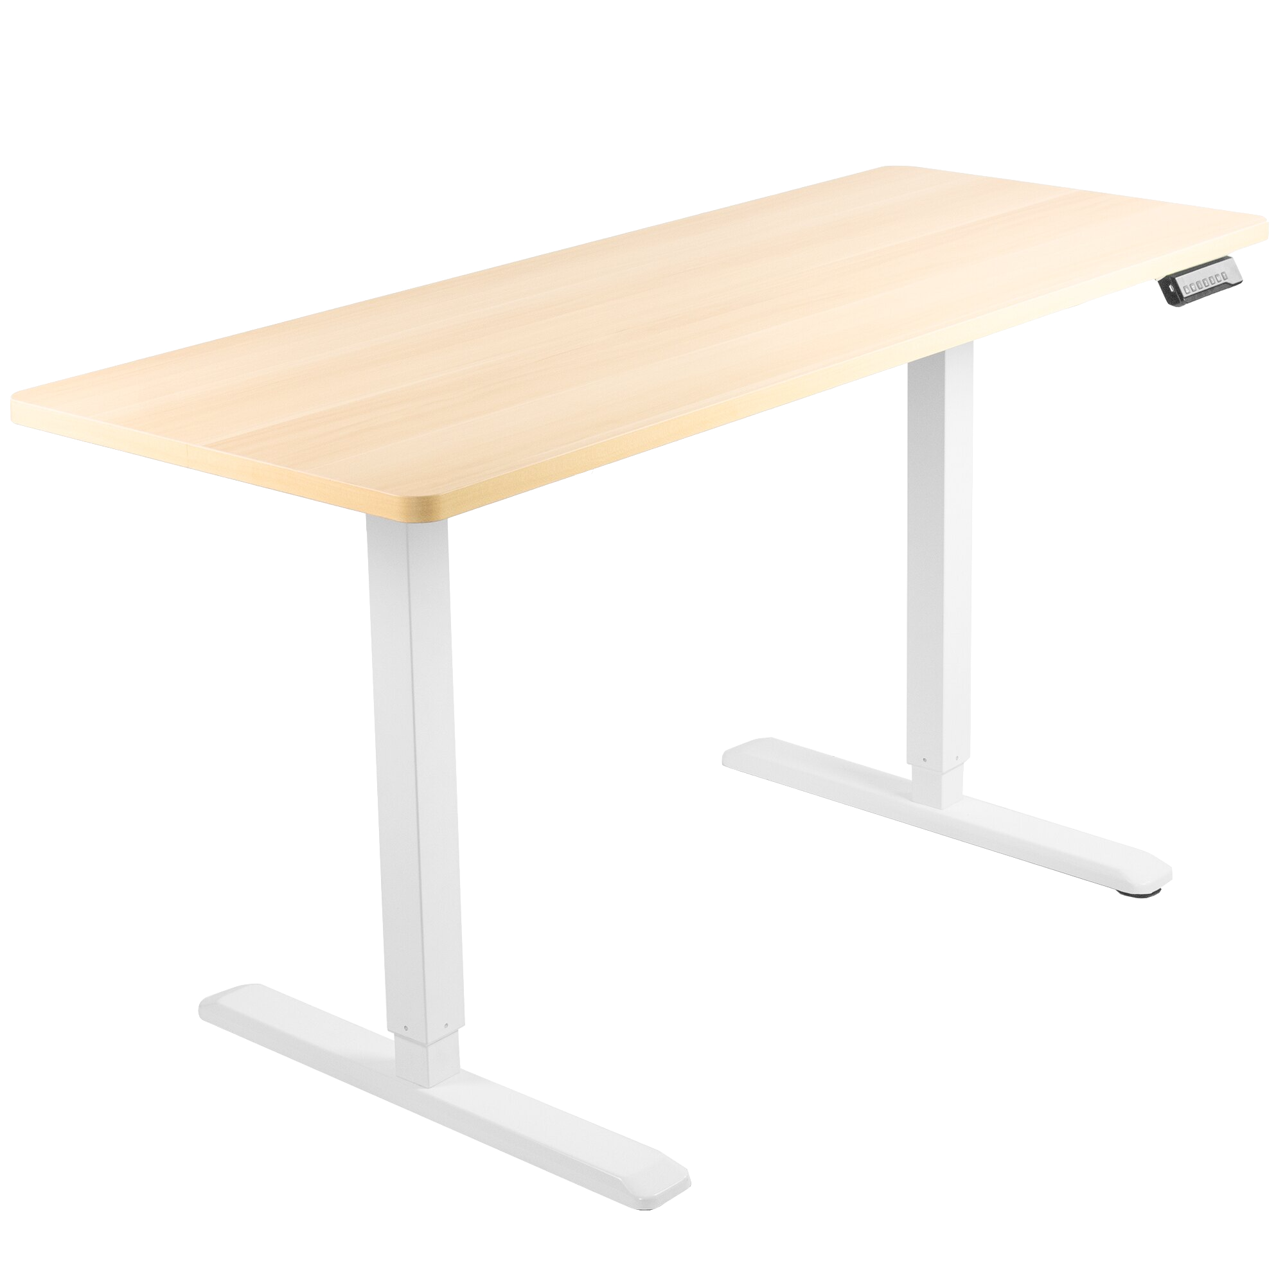
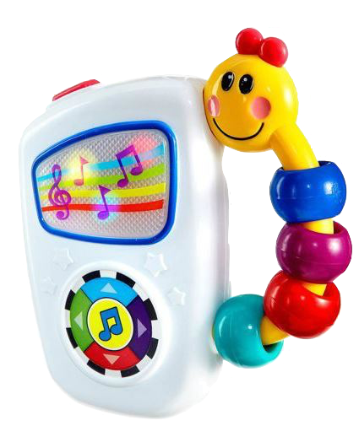
Devices we adapted
Musical Toy
Overbed Table (Motorized Table)

Slide 8
Key Terms
Intent: An action that fulfils a user’s spoken request
Utterance: A likely phrase that will call an intent
Directive: A message sent from AVS telling a client to perform a specific action
Notes:
New Terms

Slide 9
Demo

Slide 10

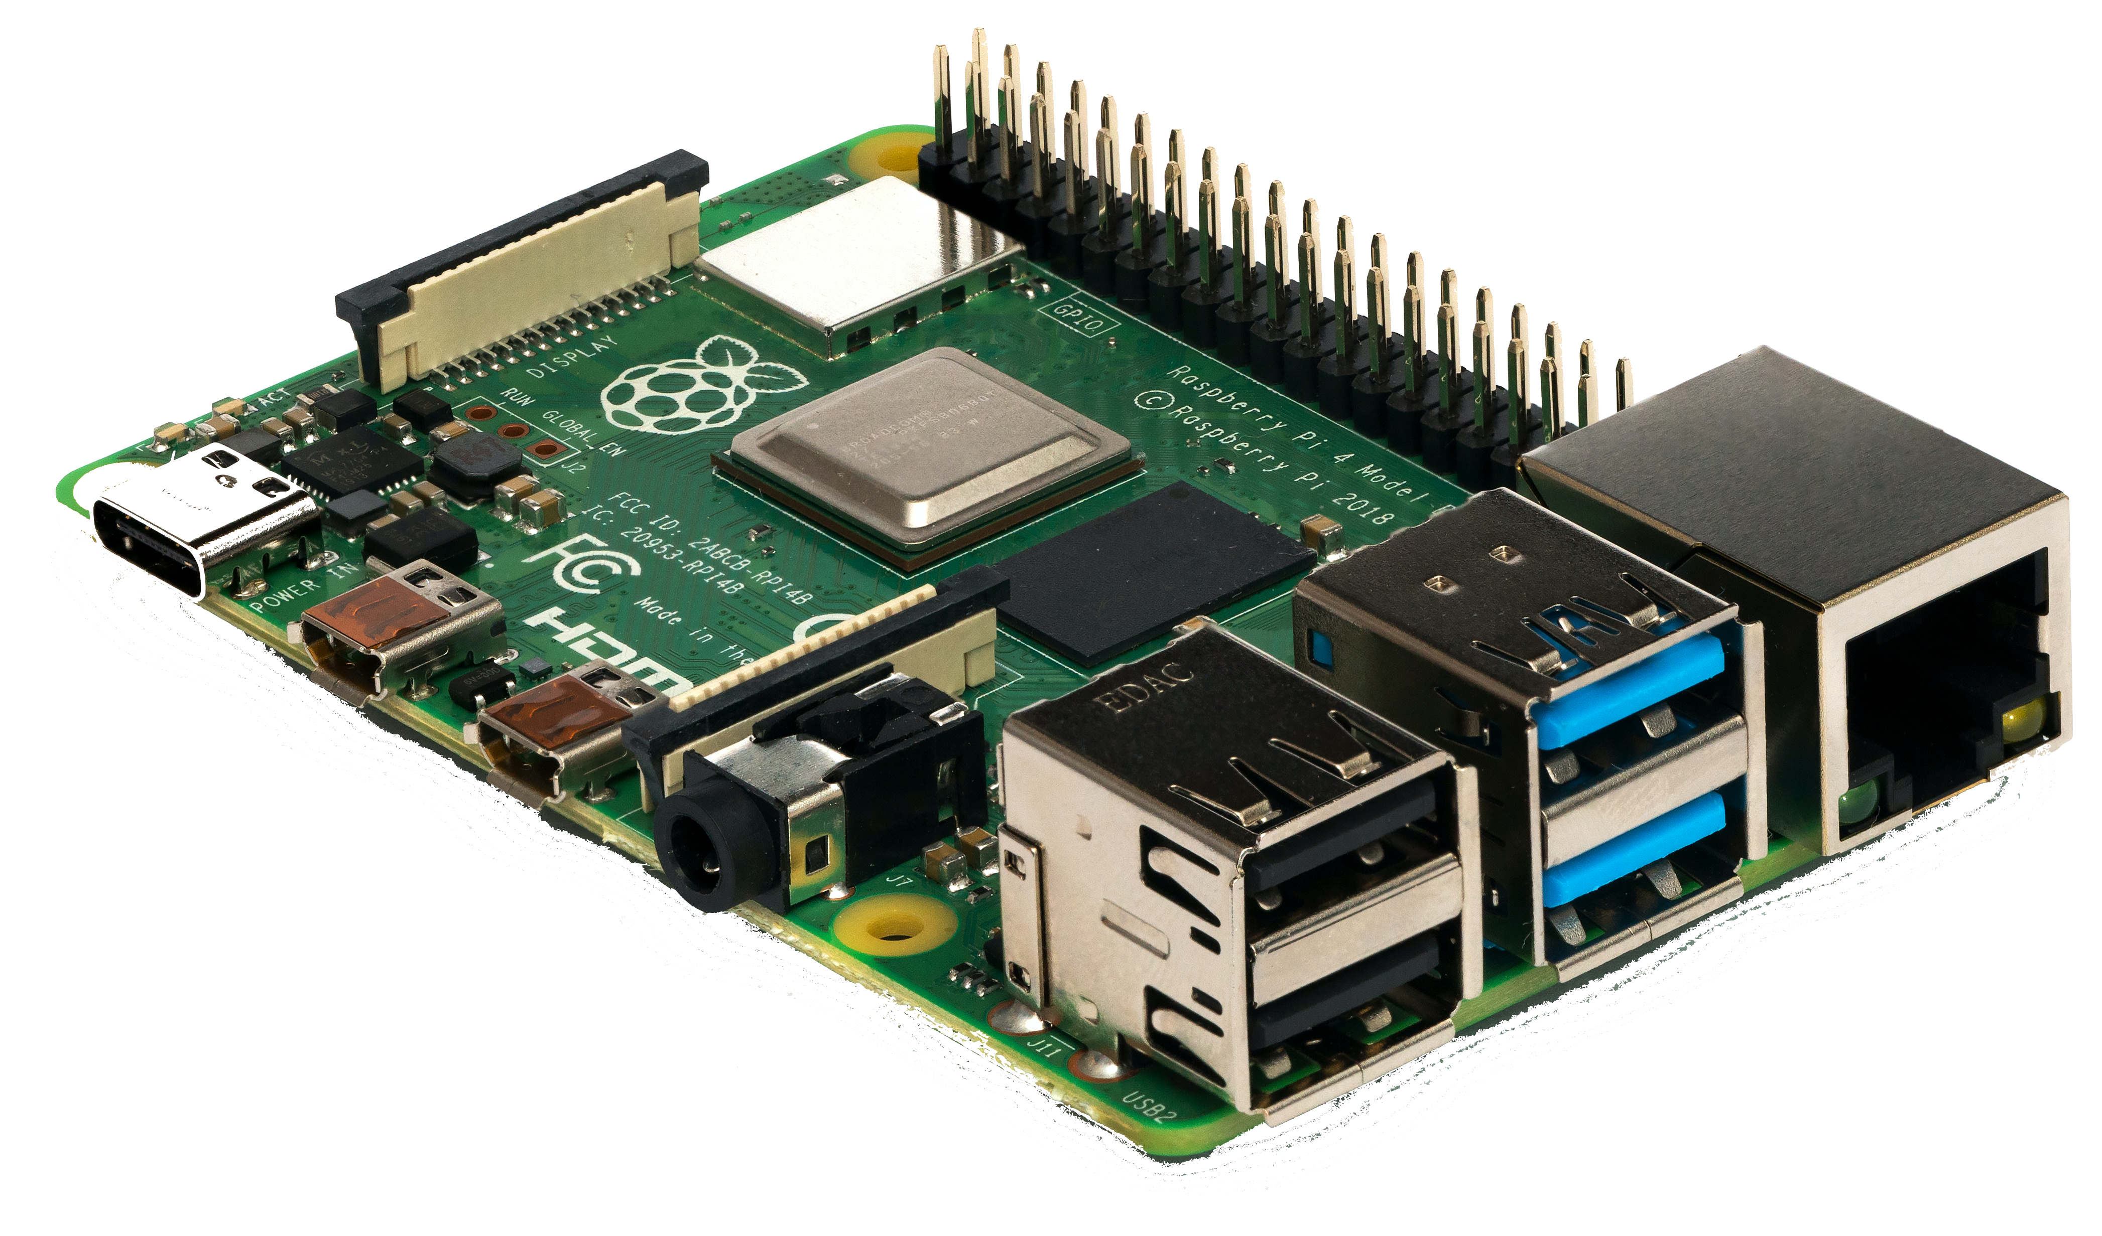






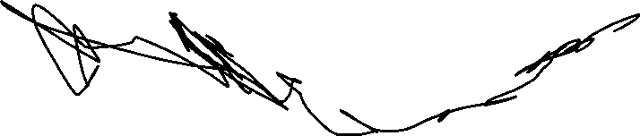
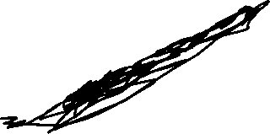




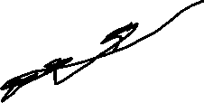
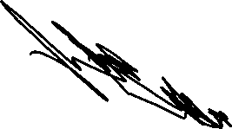
Raspberry pi
This Photo by Unknown author is licensed under CC BY-SA.
Notes:
RPI
One of the key devices in our project.
The device is a small, single-board computer that we used to handle the hardware side of the project.
When we started working with this device, it became very clear why it was suggested by our client.
We have quickly found that using this device had many advantages.
The first advantage we realized was the availability of the device. Since the device was commonly used, there are a lot of documentation and tutorials available.
Another benefit of using Raspberry Pi was it's flexibility. The device can handle many different tasks.
The device also has a Gui interface, which makes it very easy to use the device for development purposes.

Slide 11

Let’s take quick look.

Slide 12
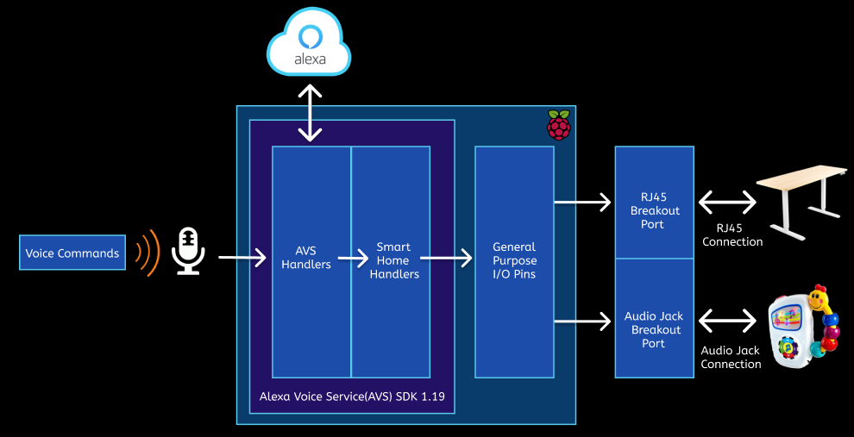

Slide 13
Notes:
Voice Command blue oval.

Slide 14

Client Communicates with Alexa
Notes:
Redo Title

Slide 15
Notes:
Voice Command blue oval.

Slide 16
Notes:
AVS then receives that event.
Within AVS, it supports features such as speech recognition and voice processing.
*Make Red Thicker*

Slide 17
Notes:
However, your words that you spoke are sent into the Alexa cloud.
This is where Alexa cleans up the audio to recognize what action to take.
*Spacing between arrows consistent.*

Slide 18

Alexa Voice Service (AVS)
Client’s Audio Request
Device ID Intent
Notes:
Alexa Cloud Explanation on Alexa Cloud on the Slide Before. Give a high-level understanding don’t go into too much detail.

Slide 19
What is Alexa cloud?
Translates utterance to text.
Finds intent from the speech recognized.
Maps that intent to a specific skill in the Alexa Cloud.
Translates text response from Alexa to audio speech.

Slide 20
Notes:
However, your words that you spoke are sent into the Alexa cloud.
This is where Alexa cleans up the audio to recognize what action to take.
*Spacing between arrows consistent.*

Slide 21
Notes:
AVS then receives that event.
Within AVS, it supports features such as speech recognition and voice processing.
*Make Red Thicker*

Slide 22
Notes:
Once Alexa figures out what action to send back. This is also known as a directive.
Once the directive arrives, we have a set of handlers that deal with the local functionality of the Rpi such as turning on a toy.

Slide 23
Notes:
To do this, we connect different switch devices through the Rpi hat’s general purpose pins. We can then recognize what devices are connected and what capabilities each one has.
Since we figured out what devices are connected, the Alexa cloud knows that too. If you see a request for this toy, that’s me. Route it back directly to me.
This is especially powerful because Alexa directives can come straight back down the same connection. There are no other hoops to jump through.
The traditional way was to have external cloud manage a device’s iot control. Essentially, it had to go from the Alexa cloud->Call an Alexa skill->Device cloud->back down to device.

Slide 24
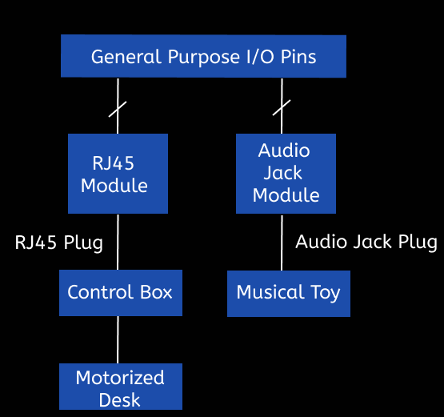
Pluggable Interfaces
RJ45 for Motorized Table
Audio Jack for Musical Toy

Slide 25
Minimum Viable Loveable Product
Enable voice commands to the Alexa Modular Adapter to control different devices:
Adjusting the height of a motorized table.
Changing the song being played on a musical toy.
Setup by voice
Notes:
Rewritten

Slide 26
What’s Next?
Expand compatibility with different appliances including IR/RF control

Slide 27
What we Learned
Alexa Platform
Tradeoffs between different design implementations
Notes:
Expand more.
We had to be more conscious on electronic platforms like Slack and Zoom in order to keep everyone up to date.

Slide 28
Thank You!
We want to thank Sarah Caplener, David Frerichs, Ken Karakotsios, Kara Kytle, and everyone at the Alexa for Everyone Team for this amazing opportunity.
We appreciate the guidance from the teaching staff including Instructor Richard Jullig, Professor Patrick Mantey, and TA Arindam Sarma.
We would like to acknowledge our former team members, Bryan Jimenez and Cagan Bakirci for their contributions.

Slide 29
Questions?

Slide 30
Citations
https://techcrunch.com/2020/02/10/nearly-70-of-u-s-smart-speaker-owners-use-amazon-echo-devices/
https://www.statista.com/statistics/794632/us-amazon-echo-quarterly-installed-base/
https://designbundles.net/marco-livolsi/301556-microphone-icon?storeproduct=true&store=marco-livolsi&id=301556&product=microphone-icon?storeproduct=true&store=marco-livolsi&id=301556&product=microphone-icon

